Slide 1

The 2017 TRICS User Survey and Forthcoming System Developments
Nick Rabbets, Managing Director, TRICS Consortium Limited
Notes:
In this presentation I am going to present the results of the 2017 TRICS User Survey, and go through a few system development ideas that users have given us.

Slide 2
TRICS User Survey & System Developments
User Survey sent out to all TRICS users annually.
This presentation will present the findings of the 2017 User Survey.
Findings are based on a total of 85 responses.
User Assessment of TRICS
Suggested future system developments and research topics discussed.
Notes:
The TRICS User Survey is sent out to all member organisations annually. This year the survey was sent out in March, giving us plenty of time to assess the results prior to the User Meeting. In total there were 85 responses, and these consisted of a user assessment of TRICS along with ideas for future system development and research.

Slide 3
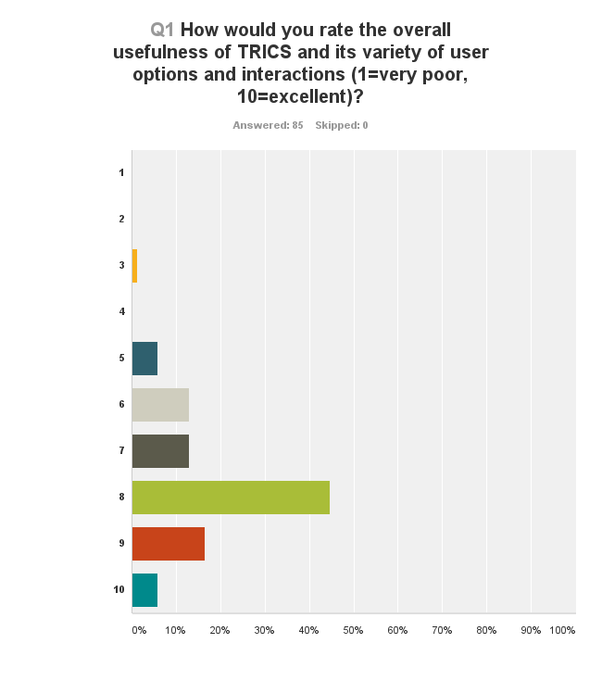
Question 1
“How would you rate the overall usefulness of TRICS and its variety of user options and interactions?”
(1 = very poor, 10 = excellent)
Notes:
Let’s go through the first few questions of the survey, which focused on how users currently find the TRICS system in terms of its every day use. The first question asked “how would you rate the overall usefulness of TRICS and its variety of user options and interactions?” The results are shown from the top of the graph as 1 for very poor, and at the bottom as 10 meaning excellent. The x-axis shows increments of 10% of responses. So, we can see that the highest scoring number out of 10 is 8, with some 45% of responses. However, we can see that we have room for improvement, which is always what we are trying to do at TRICS.

Slide 4
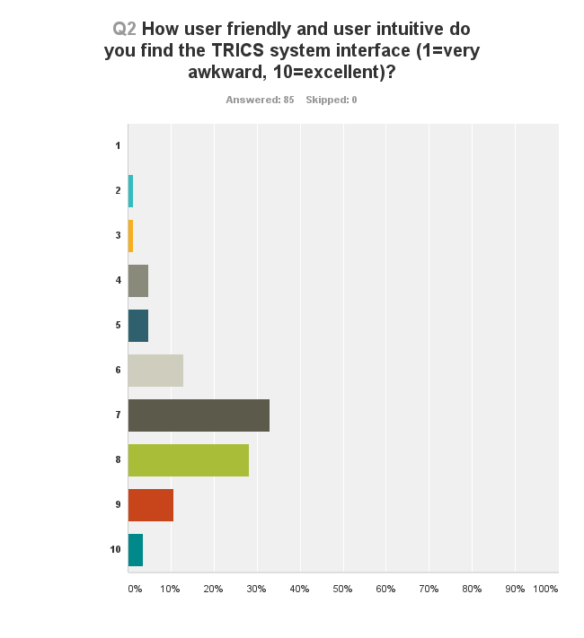
Question 2
“How user friendly and user intuitive do you find the system interface?”
(1 = very awkward, 10 = excellent)
Notes:
Question 2 asked “how user friendly and user intuitive do you find the system interface?” The scores here are quite similar to the previous question, although slightly lower overall, with the highest grouping being 7 out of 10 (around 33% of responses).

Slide 5
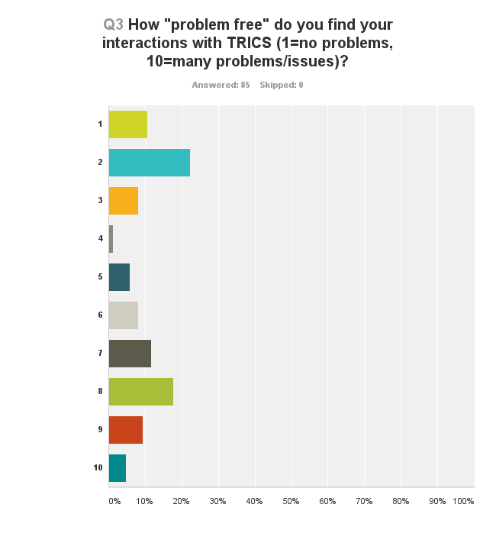
Question 3
“How ‘problem free’ do you find your interactions with TRICS?”
(1 = no problems, 10 = many problems/issues)
Notes:
Question 3 asked “How ‘problem free’ do you find your interactions with TRICS?” The answers to this were very mixed indeed, with no score out of the 10 being particularly dominant. This gives the TRICS team an opportunity to ask you today what the problems you experience with TRICS are, perhaps in this afternoon’s open forum session. We would very much like to get to grips with any issues that users have with the system, so now is your chance to have your say.

Slide 6
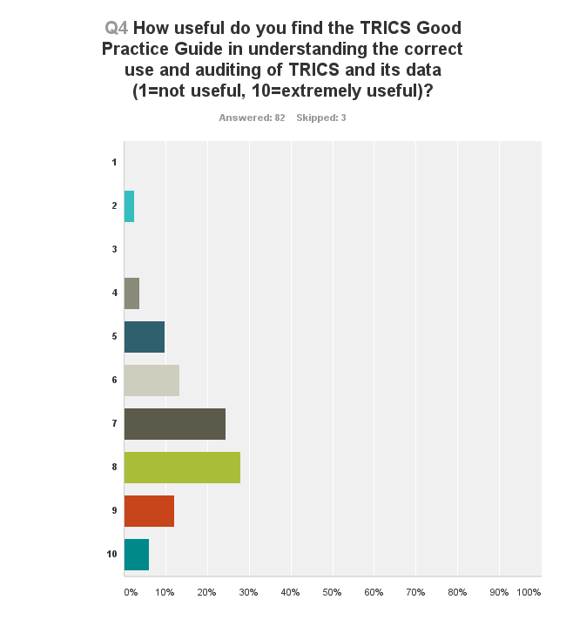
Question 4
“How useful do you find the TRICS Good Practice Guide in understanding the correct use and auditing of TRICS and its data?”
(1 = not useful, 10 = extremely useful)
Notes:
Question 4 now. It asked “how useful do you find the TRICS Good Practice Guide in understanding the correct use and auditing of TRICS and its data?” The Good Practice Guide is very important to us here at TRICS, and we know it is important to the users too. It is good to see that this importance is reflected in the results of this question to a good degree, mostly around the 7 and 8 out of 10 mark, with some variation of course. However, we will be aiming to improve on this result by continuing to listen to users and enhancing and updating the guidance at regular intervals.

Slide 7
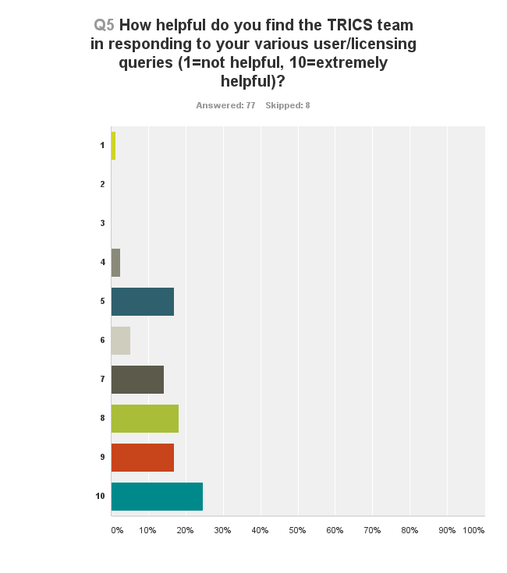
Question 5
“How helpful do you find the TRICS team in responding to your various user/licensing queries?”
(1 = not helpful, 10 = extremely helpful)
Notes:
Question 5 asked “How helpful do you find the TRICS team in responding to your various user/licensing queries?” It seems most people quite happy how we deal with your queries. At TRICS we like to offer the best service to all of our users, and this is much valued feedback from you.

Slide 8
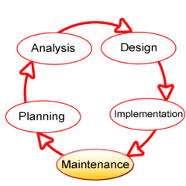
System Developments
System Developments Introduced in the last year or being introduced shortly
Notes:
Moving on from the general questions about TRICS, we can now move into system development specifics. We found this interesting diagram online, what is known as the Systems Development Lifecycle. This is particularly appropriate to the ongoing development of TRICS, as it does represent the way in which we work with our users and implement new system features. The way in which our system is interactive with its users in its ongoing development is very important to us, as this unique approach has allowed us to evolve the system over 27 years now.

Slide 9
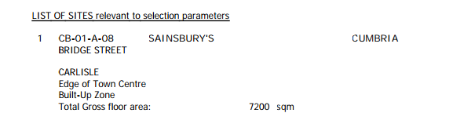
Option for Enhanced Selected Sites Summary
This will give users the option to increase the information provided when viewing the trip rate calculation screen and will be printed on the output pdf.
From:
To:
Site (1): CB-01-A-08 Gross Floor Area: 7200m2
Development Name: Sainsbury’s Retail Floor Area: 5800m2
Location: Carlisle Parking Spaces: 457
Postcode: CA2 5SX Employees: 307
Main Location Type: Edge of Town Centre Survey Date: 06/06/14
Sub-Location Type: Built-Up Zone Survey Day: Friday
PTAL: n/a
Notes:
Here are some system developments that have already been included over the past year or will be included shortly. “Selected Sites Summary” this precedes the trip rate calculation outputs with some key site and development details. You can see from the slide the detail of the standard sites summary compared to the enhanced version.

Slide 10
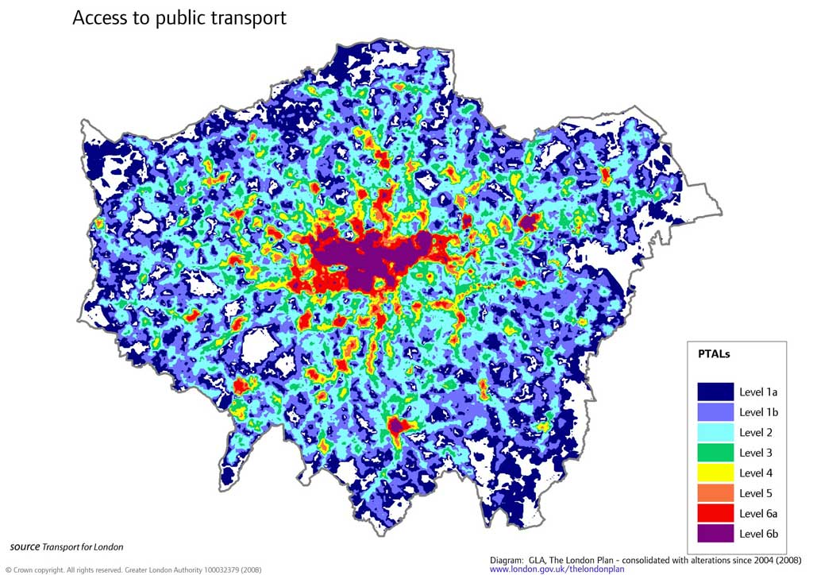
PTAL Filtering
Introduction of PTAL level filtering for surveys in Greater London.
we have collected PTAL information for our Greater London sites for a number of years which has now enabled an additional filtering parameter to be provided for London-only datasets.
Notes:
Filtering of sites by PTAL level for surveys in Greater London. TRICS has been collecting this data for Greater London sites for as number of years now. So much so, we think there is enough data to now include a filter for London Only data sets.

Slide 11
Summary Trip Rate Table
Provide a summary table of trip rates for key periods such as AM, PM and User Defined Period.
Above the 24-hour trip rate results table A fixed 0800-0900 & 1700-1800, as well as a User Defined Period would display the in, out and total trip rates for the displayed user class.
Trip Rates for Key Periods |  | Trips per 100m2 GFA
Period | Inbound | Outbound | Total
0700-0800 | 3.16 | 0.87 | 4.03
1700-1800 | 0.44 | 4.08 | 4.52
1600-1900 | 0.97 | 6.93 | 7.90
Notes:
The next improvement is to provide a summary table of trip rates for key periods to accompany the existing results table. Above the 24-hour standard trip rate calculation results table we have inserted a summary trip rates for two standard peaks of 0800-0900 and 1800-1900, plus a user-defined period. You will note the user defined period does not need to be restricted to a single hour.

Slide 12
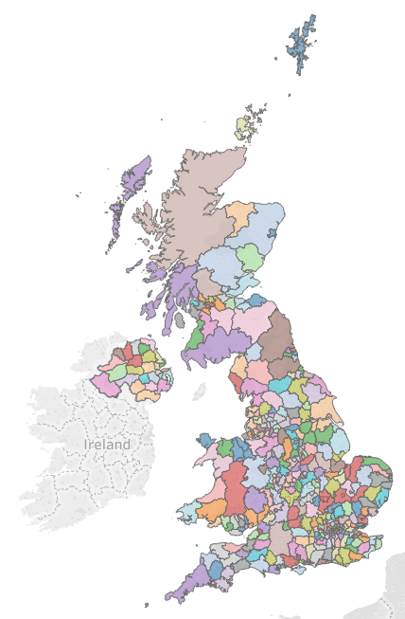
Additional Site Details
Include the name of the Local Planning Authority for each new site.
It is hoped that this piece of information will assist the user in contacting the correct Local Planning Authority if further information regarding the surveyed site is required .
Notes:
This was a request to assist the user in finding additional information. For some complicated sites it may be necessary for the user to contact the Local Authority a TRICS site is associated with, perhaps to find out additional information upon local conditions or travel Plan information. This additional piece of information just helps the user know the Local Authority (at the time of the survey being undertaken of course). As with all of our systems improvements , this will of course only apply to new sites entering the database.

Slide 13
Filtering Summary Table
Provide a summary table of Filters Applied to attain the Trip Rate.
An additional facility to enable Auditors and Users of the provided Trip Rate Data to see what Filters have been used during the TRICS process. Summary Table will be included within the TRICS Output.
Notes:
The final system development for the December release is a summary table of the user defined filters used during the particular trip rate calculation. It is hoped that this additional information will allow users and auditors alike to understand the reasoning behind the calculation undertaken and it will be included within the final output.

Slide 14
Filtering Summary Table
Filtering Summary
Land Use: 01/A Retail/Food Superstore
Selected Trip Rate Calculation Parameter Range: 4000-8000m2 GFA
Actual Trip Rate Calculation Parameter Range: 4238-7739m2 GFA
Date range: Minimum: 01/01/08 Maximum: 25/09/15
Days of the week selected Saturday 13
Main Location Types selected: Edge of Town
Suburban Area
Population <1 Mile ranges selected 10,001-15,000 8
15,001-20,000 3
50,001-100,000 2
Population <5 Miles ranges selected 75,001-75,000 4
100,001-125,000 4
250,001-500,000 3
500,001 or More 2
Car Ownership <5 Miles ranges selected 0.6 to 1.0 6
1.1 to 1.5 6
1.6 to 2.0 1
PTAL ranges selected n/a
Notes:
Here is what the Summary Table will look like

Slide 15
New Land Use
As well as System Developments we also look at Survey requirements of the System.
Over the past year we have introduced Continued Care Residential Community (CCRC) surveys. Users comments showed that a new land use was starting to emerge. System now has 10 sites within Retirement Flats Category, but will be moved to their own Category in the New Year.
Notes:
To ensure TRICS keeps up to date we are constantly looking at development trends. One of the areas we found was lacking was a new type of development, the Care Community, this is where active elderly join the community in perhaps a one or two bedroomed house and gradually move within the community once their health requires it. Many of these developments have separate housing, warden assisted flats and full care facilities.

Slide 16
Suggested System Developments
Here are a few System Developments suggested within this year’s User Survey
Notes:
We now move on to some of the ideas suggested by people in this year’s Annual Survey. I hope that the next few slides will enable you to think about suggestions for this afternoons Forum Session. Once we have had our discussions today, we will go away and formulate a programme of system development to take place over the second half of this year

Slide 17
Post Construction Analysis
“Comparison between Trip Rates agreed at Planning Stage and Surveyed Trip Rates.”
TRICS Response: This is something TRICS has been trying to promote for a while.
Notes:
This is something that TRICS has been trying to promote for some time now and something that I think will start to become more of a requirement during the monitoring of Travel Plans. It does need the agreement of the Developer and Author’s of the Transport Assessment to undertake this, but as we become more aware of the linkage between TA and TP I think it will start to become more of a requirement by the Local Highway Authority. From my own personal involvement with these things there are many people who write TA’s who don’t like the idea of navel gazing. In many parts of the world this type of post construction assessment is part of the whole process and without it the Industry will not progress and learn from the experiences.

Slide 18
New Land Uses
Many New Land Uses Suggested Including:
Budget Supermarkets
Drive Thru Coffee Shops
Private Care Homes
Trampoline Centres
Hand Car Wash facilities
TRICS Response: Many of these uses are being surveyed within our Annual Data Collection Programme. Budget Supermarkets will be discussed in a separate paper today.
Notes:
TRICS always tries to take on board the emerging land uses whenever we can. However, they have to be built before we can survey them and we do need the permission of the site owner to undertake surveys. We have been trying over the past few years to get a number of Coffee Drive Thus, however, getting permission to undertake these surveys is the big problem; a number of larger organisations do not want TRICS to survey their sites.
Budget Supermarkets – is there such a thing now or have they actually become main stream? This will be discussed in greater detail later this morning.

Slide 19
Servicing Vehicle Counts
“More data on servicing movements for all different land uses.”
TRICS Response: Detailed Servicing surveys are being undertaken within Greater London and this may be extended to all of the UK at a later date. Once the level of data for this increases it may result in a new detailed Servicing Vehicle output to be provided.
Notes:
TRICS already undertakes detailed servicing vehicle counts within Greater London and this may very well be extended to all parts of the UK, if users think it would be of assistance and add value to the system. Once these surveys start to increase it may be necessary to create a more detailed output for Servicing Vehicle data.

Slide 20
Car Clubs
“Identifying how many people use Car Club vehicles in any survey.”
TRICS Response: This is something TRICS will consider in greater detail within the Survey Methodology and may include an additional mode “Car Club”.
Notes:
This is an aspect which may have interest within the Industry, not just for the Trip Rate side of things. TRICS is very aware that Car Clubs and other similar schemes are becoming more popular, especially within the major cities. The only thing I can see being a problem is ensuring that the survey can actually pick-up these car club vehicles. I am aware that many have prominent logos on the vehicles advertising the car club, but some are more discreet, with only a small window sticker. We will also have to consider “Driverless” vehicles when they start to appear.

Slide 21
Future TRICS Research Ideas
Notes:
Moving on now from system development to research ideas. Over the years, TRICS has commissioned and undertaken a variety of research projects, the most recent one being the December 2014 publication “Pass-By & Diverted Trips”. Our User Survey always asks for ideas about potential future projects, and we have picked a few suggestions out to gather further food for thought at this afternoon’s open forum.

Slide 22
User Survey Research Ideas Summary
Impact of installing “Amazon Collection Point” facilities at Garages and Local Shopping Centres.
Re-Surveys of TRICS sites to see how travel modes and trip rates changes over time.
Implications upon the size of dwelling to trip rates observed, i.e. 5 Bed Houses to 1 or 2 Bed Houses.
Is there any difference between Discount Food Retail to normal Food Retail now?
Notes:
The suggestions from the users were varied and quite interesting. I have taken the many and brought it down to a few that might enable some discussion later in the day.
Amazon Collection Points – Are they having an impact upon traffic generation? An interesting point this one, does there actually need to be Planning Permission for these facilities to be provided? If there is a perceived problem with this perhaps we need to find a number of locations and do before and after surveys.
Re-Surveys – TRICS does try and undertake these surveys when we can, but if you the users think these are helpful we could try and do more of them.
Dwelling Size – Another interesting one, the Industry has always assumed that dwelling size has an influence upon the Trip Rate. However, I’m not so sure it has a great influence. From personal experience, I think that I generated more trips when I was living in a two bed house than I do now. This could be something that we look into when we are undertaking some of our residential surveys.
Discount and Regular Food Retail – Is there actually now a difference or are Lidl and Aldi now a regular Food Retail store?

Slide 23
User Survey Research Ideas Summary
Does adjacent highway flow have a relationship to Petrol Filling Station trip rates?
Comparison of trip generation before and after the introduction of Car Club provision.
Trip rate comparison between GFA and RFA in Modern Supermarkets.
Trip purpose from Residential sites.
Notes:
Petrol Filling Stations – Does the adjacent flow on the highway influence the trip rate? This is something that I have been considering for some time now and something I would like to discuss later this afternoon. We are looking to test some additional information that could be collected whilst undertaking TRICS surveys and this may very well assist in this question.
Car Clubs – Do they actually have an impact. I suspect this would be a good one to have as part of the assessment of a Travel Plan Survey and also how usage of the Car Club changes over time.
GRA/RFA Comparison – I assume this is because modern Supermarkets are increasing their RFA proportion with some storage facilities being provided in containers within servicing areas.
Trip Purpose – This would then enable some comparison with the National Travel Survey and may be possible if we ever progress a Level 4 TRICS survey. We are not able to stop traffic on the highway, therefore, this element would have to be collected by some form of survey completed by the people living within the development. There are certain aspects that we can make an educated guess at, such as delivery vehicles etc, but this information will never be truly accurate. However, it is something that we could investigate for some of our more detailed surveys.

Slide 24
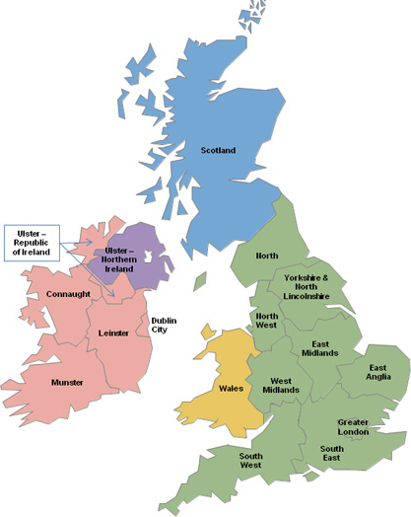
Where would you like to see more TRICS surveys (10 being maximum priority)?
South East 7.6
South West 7.0
East Anglia 6.6
East Midlands 6.6
North West 6.5
West Midlands 6.5
North 6.4
Yorkshire & N. Lincs 6.4
Greater London 6.2
Notes:
There were a few other questions at the end of the User Survey that I can just run through with you. We asked users to score the 17 regions of TRICS in order of priority for future surveys (scores out of 10), and the averages are shown here. This year the highest scoring region was South East, with an average of 7.6 out of 10. Some other familiar regions are again ranked highly, with South West in second place. We will use this information when preparing our 2018 data collection programme allocations across the regions, so you can be sure that your feedback is definitely used as we move forwards.

Slide 25
Final Question
“Which version of the TRICS system do you use?”
Online Version Only: 90.1%
Offline Version Only: 0.0%
Both Versions: 9.9%
50% of Users using Both Versions
use Online System more than 75%
of the time.
Notes:
And finally, we asked the users “which version of the TRICS system do you use?”. We wanted to establish a baseline for the use of the online system, offline system, and both together, and here are the results. It would seem that around 90% of users used the online version only, a huge majority. This is something for us to consider as we continue to develop the system, and, eventually, look towards the development of TRICS 8 a few years down the line.

Slide 26
QUESTIONS
Please keep your Systems Development and Research ideas for the Afternoon Forum Session, or see Ian or myself during Coffee & Lunch.

